Slide 1
Analysis of Price Movement as Date Approaches Check-in Date
Shi Fan Jin (Emily)
emily00718@gmail.com
September 14, 2019
Notes:
My name is Shi Fan Jin, and you can call me Emily.
So this is my Report for the Case Study, and the title of my report is
Analysis of Price Movement as Date Approaches Check-in Date

Slide 2
Background
Most of the time, the primary goal of launching a new feature on Agoda website is to increase the number of bookings. One way to increase the number of bookings and conversion rate is to encourage customers to complete their booking as fast as possible. The call to action message that helps us to achieve that is internally known as an ‘urgency message’.
A Product Owner (PO) would like to implement an urgency message on the website such as * “Prices have been rising. Book now to lock in your rates!” * “Your check-in is fast approaching. Book now to lock in your rates!”
In order to know when and where to implement urgency message, analysis is needed. By analyzing the price movement as date approaches the check-in date, we can get business insights on the relationships of different factors, and therefore, use the results to increase the number of booking.
Notes:
This is a brief introduction for the background about the case study.
So for traveling sites, like Agoda’s. What company wants to do is to increase the number of bookings.
And in order to achieve that goal, we want customers to book faster without hesitating.
Because sometimes, customers spend a lot of time comparing different prices, and also comparing in different websites.
And that might lead to a situation where our potential customers book flights, hotels in our competitor’s website.
So to push customers to book faster, company uses what is called the “urgency message” as a strategy to create the urgency of booking.
And some examples will be like popping out a message saying:
“Prices have been rising. Book now to lock in your rates!” “Your check-in is fast approaching. Book now to lock in your rates!”
So now the question is when should we start implementing these urgency messages? And where should we implement them?
And that is the purpose of analyzing the booking data. And see if we can find out any insights.

Slide 3
Assumptions
Assuming that the 5 cities are independent and uncorrelated.
Notes:
The provided excel file consists of 5 sheets, each belongs to an individual city.
So we have the booking data of City A, B, C, D, and E, for check-in dates starting from 10/01/2016 – 12/31/2016
So before we dig into analyzing, I’m going to make this assumption.
Assuming that the 5 cities are independent and uncorrelated.
The reason why I want to assume that, is because, if we have cities that are dependent to each other,
That means there are some effects that are doubling, or canceling out. and we don’t know about that.
For example: maybe two of the five cities are very close to each other, Let’s say City A and City B
and when it’s holiday seasons, people who travel to City A will also spend a few days in City B,
and that’s doubling the tourist, the number of bookings, and even doubling the booking price.
Since we don’t have any information about these cities, and how they are related, It’s impossible for us to analyze it objectively.
And that’s the reason why I assume that in the beginning before the analysis.
FOR THE FOLLOWING SLIDES, there will be all my key findings when I’m exploring the data.
And the evidence that supports that.

Slide 4
Key Findings
The number of records in each city varies.
 | Number of Records
City A | 22366
City B | 4932
City C | 6797
City D | 10152
City E | 4817
Notes:
So let’s start with taking a look at the number of bookings (the records) for each city.
For City A, there’s more than 20 thousands bookings.
And For City B, C, E, there’s only a couple thousands of bookings
And City D has more than 10 thousands.
So we can divided the cities into two groups intuitively, City A and City D as one group, which has bookings more than 10 thousands,
And City B, C, E as another group, that has less than 10K records.
So just by looking at the numbers, we can have an idea of how each city is different from each other.
For example, City A and City D have more booking records, and in other word, have more tourists, and ”might” indicate that they are bigger cities, compare to the other three.
But, this is just an idea that we can keep in mind, it’s not definitely 100% correct.

Slide 5
The distribution of number of records over different booking date has the same pattern in all 5 cities.
Booking increases very fast around the end of September.
Notes:
And the next key finding is that The distribution of records over different booking date has the same pattern in all 5 cities.
And the booking increases very fast around the end of September.
So the following will be some plots that points to this results.

Slide 6
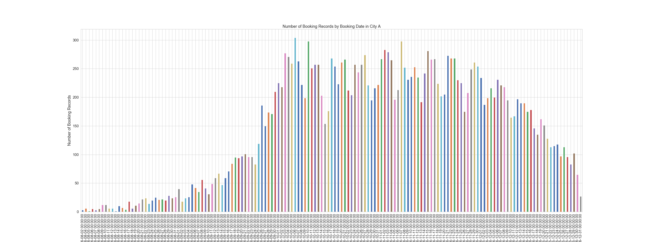
Figure 1A: Number of Booking Records by Booking Date in City A
Notes:
Because of the scale, the dates aren’t very clear, but if you zoom in a little bit, you can see from the slope that
The booking started to increase very fast around September 23, 24.
And continue to have a high number of bookings until the end of the year.
So this is for City A

Slide 7
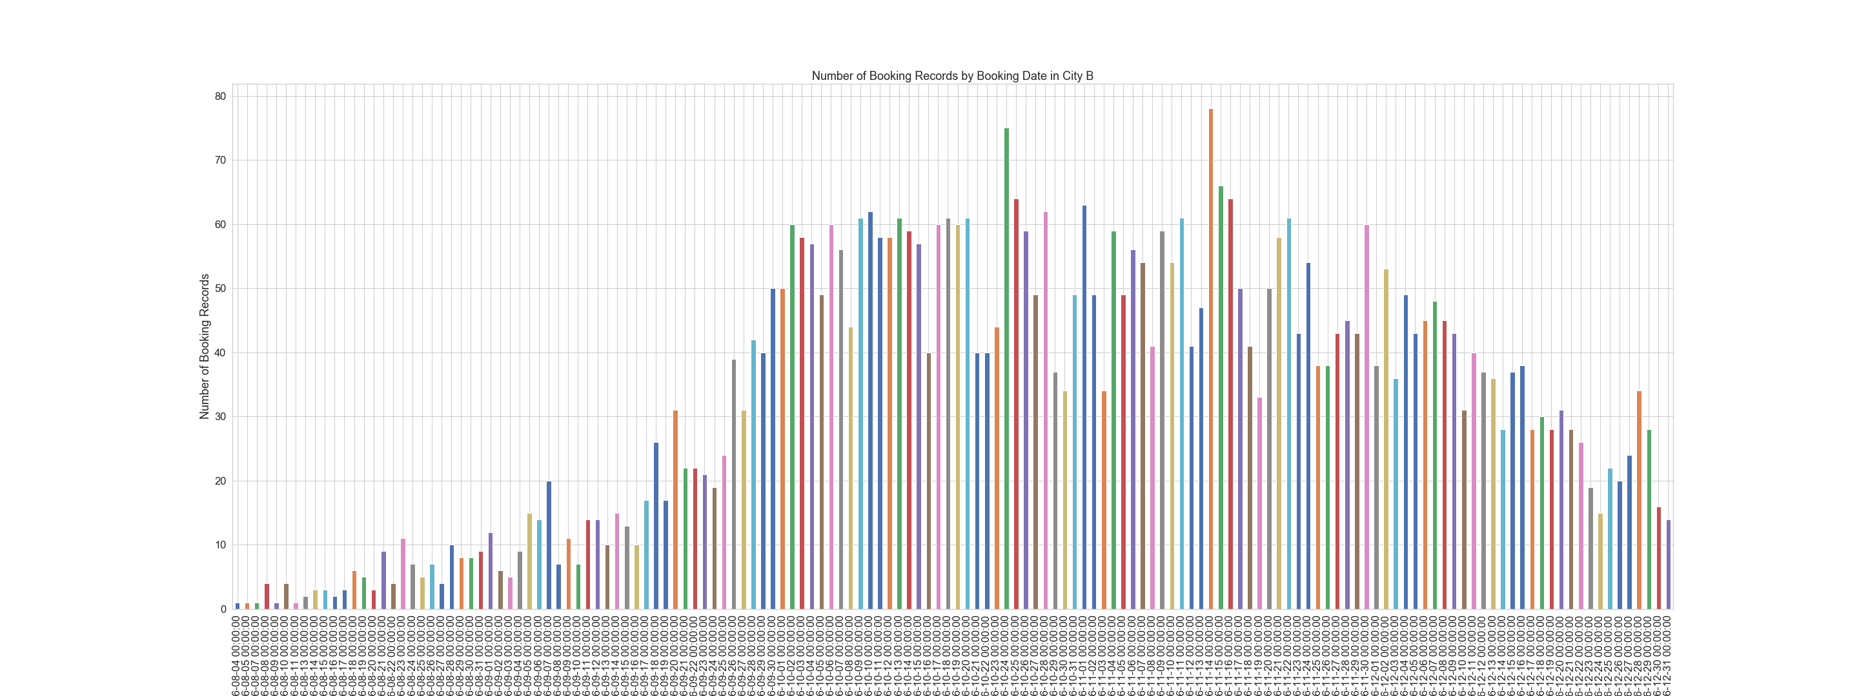
Figure 1B: Number of Booking Records by Booking Date in City B
Notes:
And the next one is for City B,
We can see the same pattern, where the number of bookings started to increase around the same time in September.

Slide 8
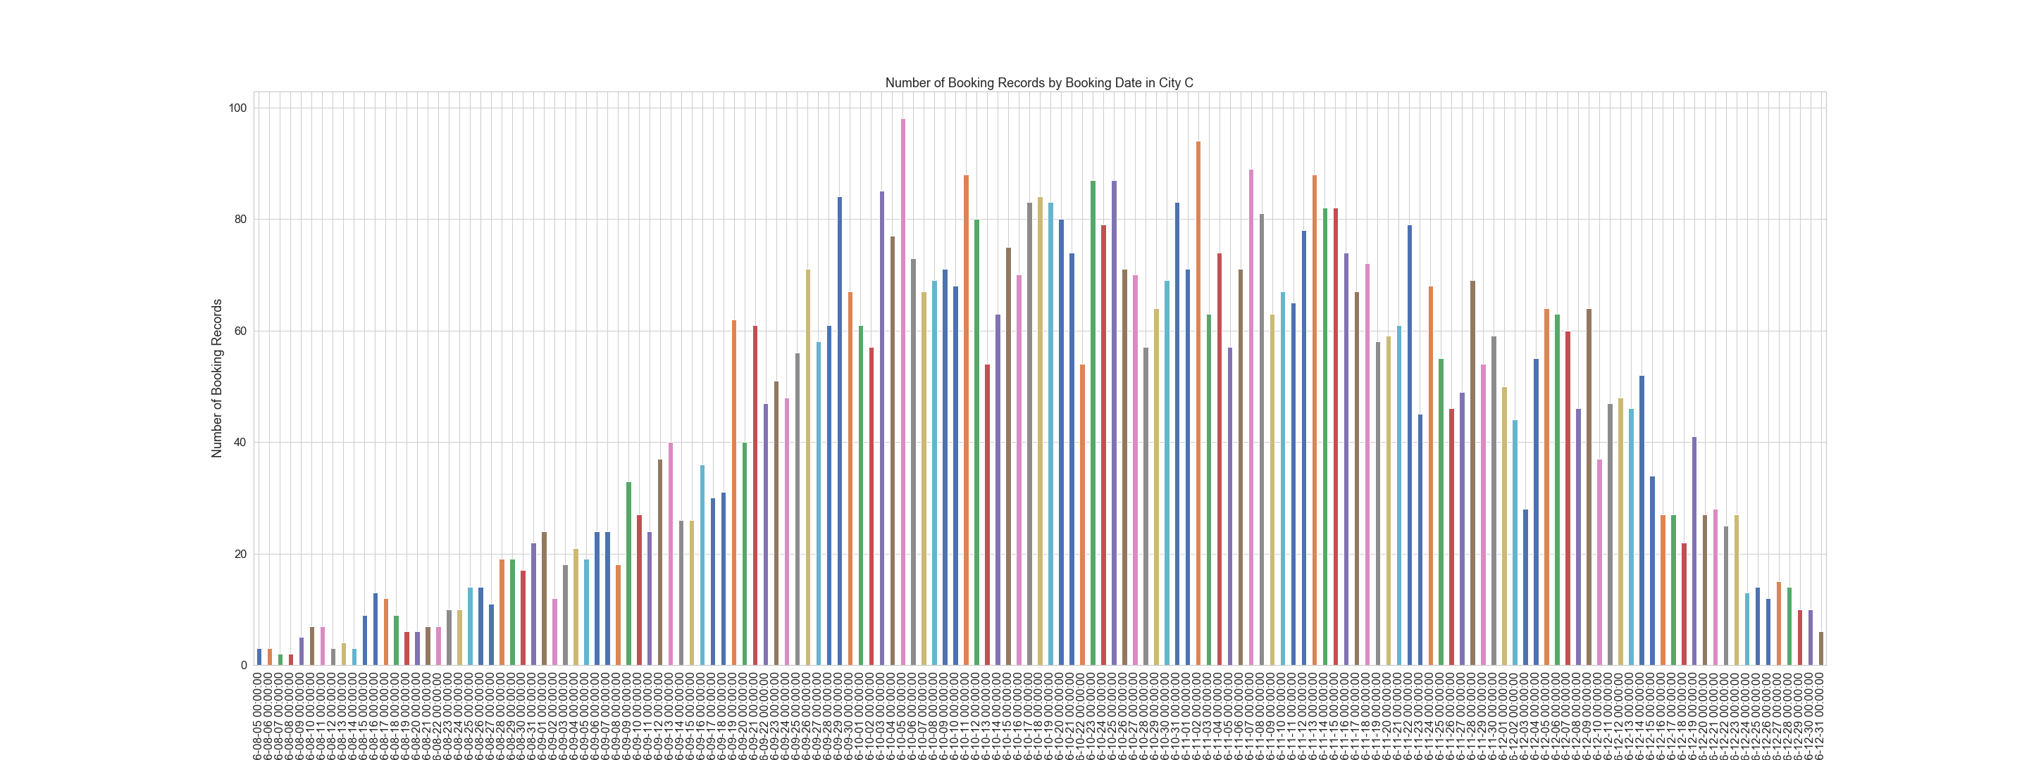
Figure 1C: Number of Booking Records by Booking Date in City C
Notes:
And for the following few slides, it shows the same thing for City C, D, and E

Slide 9
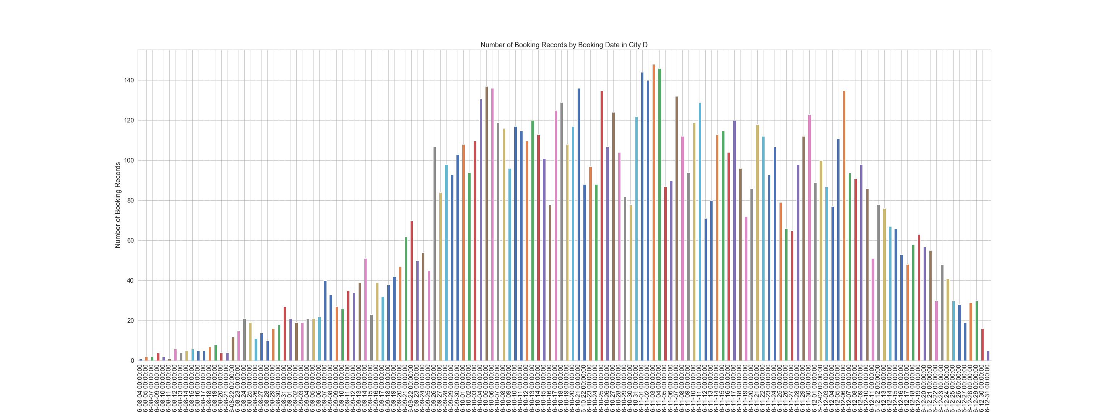
Figure 1D: Number of Booking Records by Booking Date in City D

Slide 10
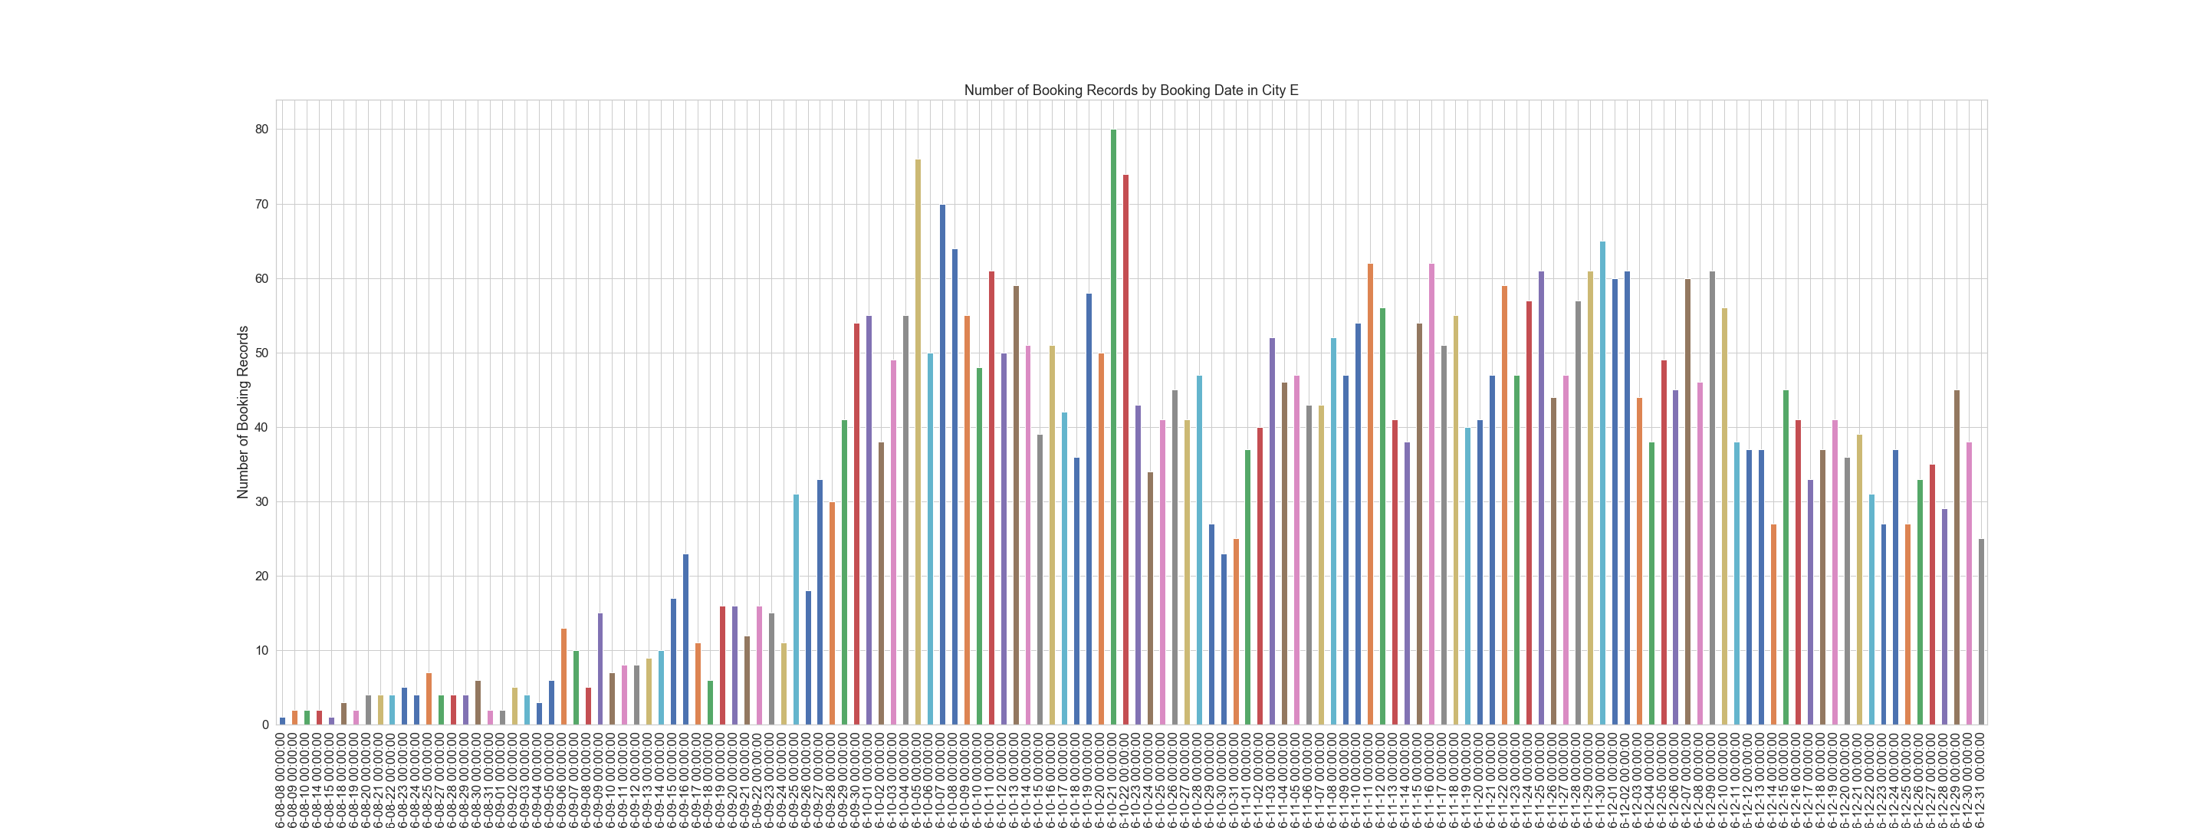
Figure 1E: Number of Booking Records by Booking Date in City E
Notes:
So the reason why the booking suddenly started to increase might be, in my opinion, because of the holiday season.
For example,
the national day for China and Taiwan, the thanksgiving holiday for western countries, black Friday, and also Christmas!
these holidays are all around this time, the end of the year.
And people started to book ahead for their vacations during these holidays.
And that might be the reason why the booking started to increase around the end of September.
And the reason why the 5 Cities have this common pattern.
(06:35)

Slide 11
Most of the bookings are made in October, November and December
Notes:
So now by changing the scale of our exploration and look at the distribution of records by the booking date’s month.
The next key finding is that,
Most of the bookings are made in October, November and December
Although we already know that our data is for check-in dates from 10/01 to the end of December.
Our earliest booking date is actually from the 1st of August.
So Let’s take a look at the following plots about the number of bookings made in each month, and in each City.

Slide 12
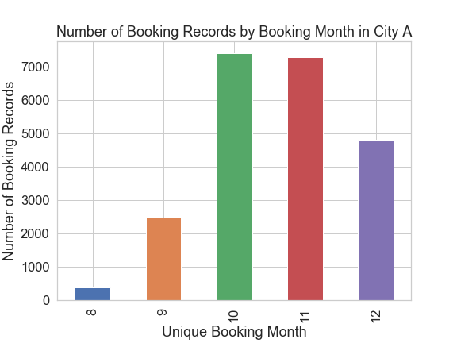
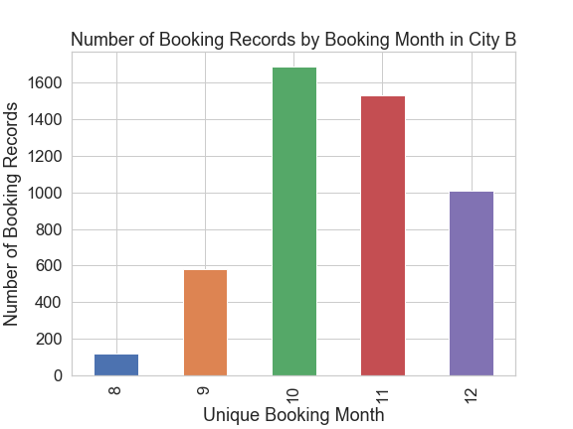
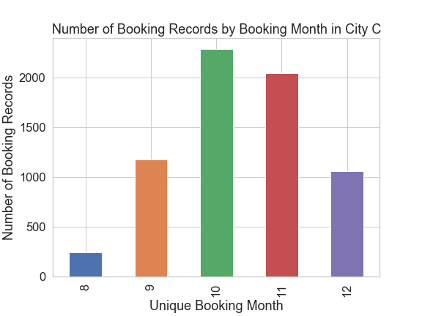
Figure 2: Number of Booking Records by Booking Month
Notes:
So these are the plots about the distribution of bookings in different months (From August to December)
We can see that most of the bookings are made in the later three months, which are October, November, December.
The green one, the red one, and the purple bar in each bar chart.

Slide 13
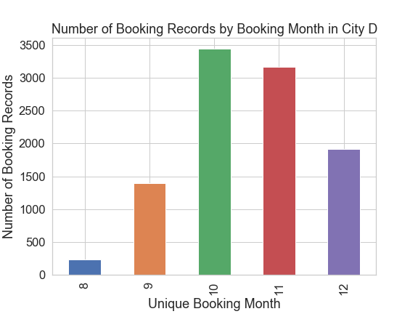
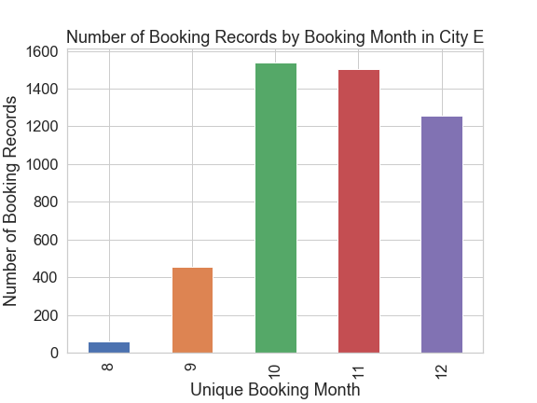
Notes:
And the same pattern in City D, and E
(08:14)
(07:47)
So let’s go to the next slide

Slide 14
The check-in records oscillate by the cycle of a week. More check-in records in the weekends.
Notes:
So one important thing to notice during my exploration, is the ”Scale” that you use to explore the data.
In other words, how zoom in, and how zoom out you use with your magnifier.
This is the same idea with when you are looking at the map,
Say if you want to explore how many countries there are, or where the countries are located.
You have to zoom out to the most on Google map.
Say if you want to explore some good restaurants around your house, you zoom in to the local streets scale.
So same idea here. In the previous slides, we looked at the booking records at different booking time as a whole, from August to December.
And then, we took a look at the numbers in each individual month.
And now, Let’s look at the distribution in a closer view.
By looking at the check-in record’s distribution,
I found out that the records oscillate by the cycle of 7 days, which is a week, and there are more check-ins on the weekends.
(09:05)

Slide 15
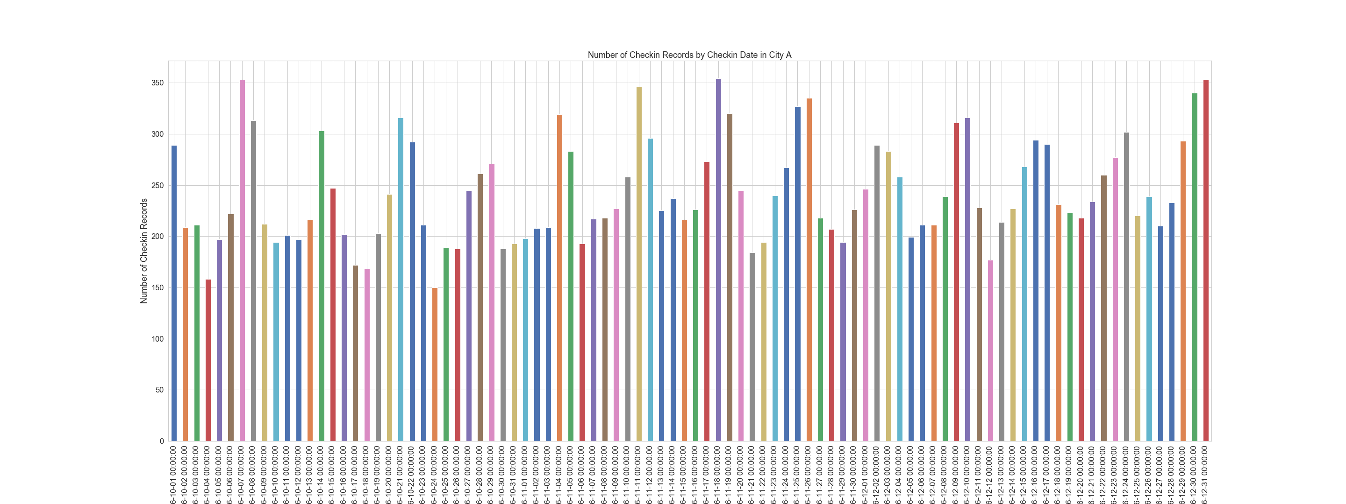
Figure 3A: Number of Records by Check-in Date in City A
Notes:
Figure 3A. Number of Records by Check-in Date in City A.
This plot shows that there is some kind of seasonal factor in the distribution when we focus on the repetitive patterns.
That tells us that there’s some kind of oscillation.
And the same pattern also appeared in the following plots.

Slide 16
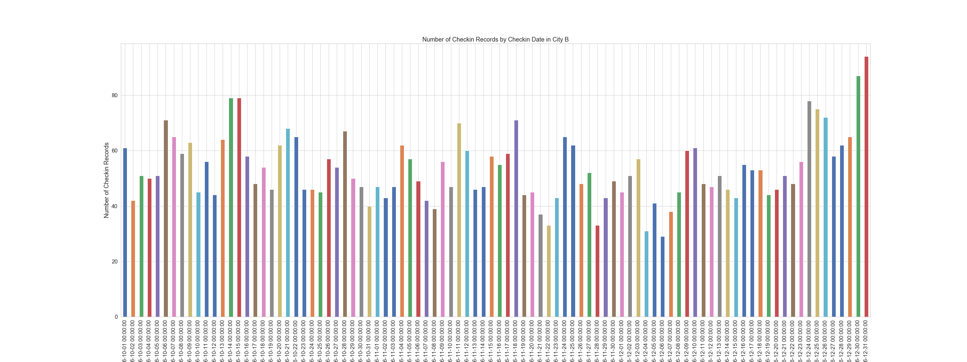
Figure 3B: Number of Records by Check-in Date in City B
Notes:
For City B,

Slide 17
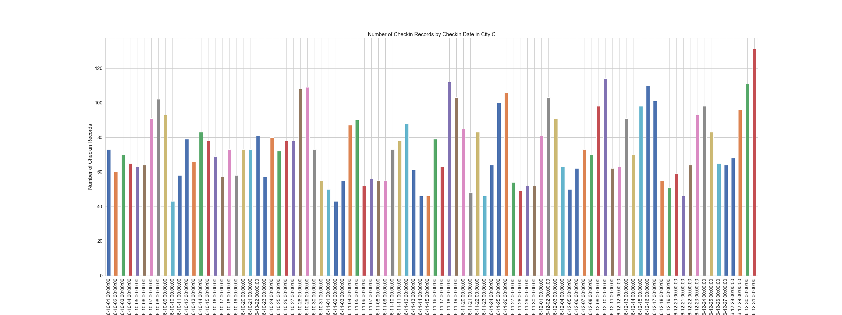
Figure 3C: Number of Records by Check-in Date in City C
Notes:
For City C,

Slide 18
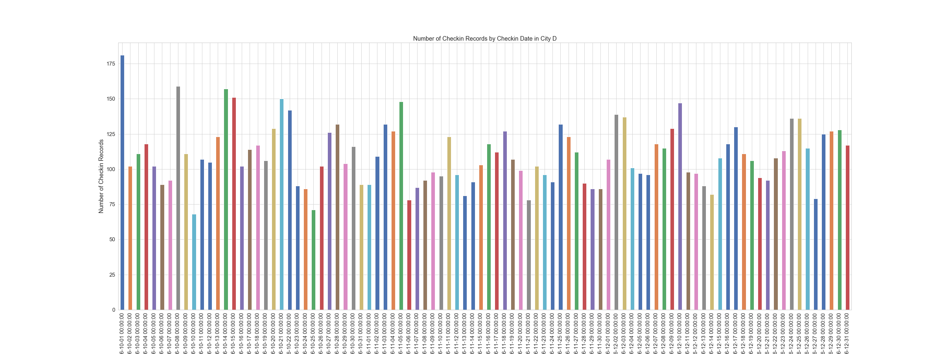
Figure 3D: Number of Records by Check-in Date in City D
Notes:
City D

Slide 19
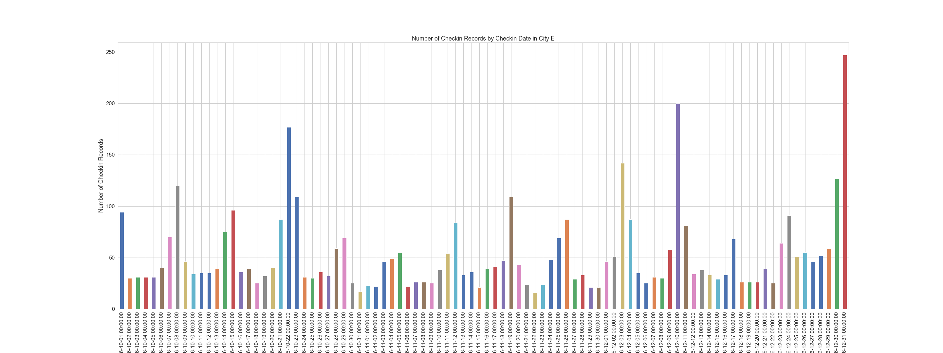
Figure 3E: Number of Records by Check-in Date in City E
Notes:
And City E.
We can see there’s this oscillation in all 5 City’s plots.
And there’s always a peek with two higher bars in the cycle.
By comparing these dates with the calendar of 2016, the two peeks turns out to be Fridays and Saturdays.
And the oscillation cycle turns out to be exactly one week, 7 days.
Well, that makes perfect sense.
People travels more on weekends since most of the people don’t have to work on these days.
So the proportion of check-ins will be higher on Friday and Saturday nights.
And Sunday nights doesn’t have as much check-ins because people have to go right to work the next day. It’s Monday again.
SO Now we have some kind of idea in different time scale, we know that
In the general perspective, From August to December, the booking increases around the end of September.
And comparing in the month-to-month perspective, most of the bookings are made in October, November, and December.
And in the week-to-week perspective, more check-ins occurs on weekends (Fridays and Saturdays)
With these key findings, Now let’s change our focus to the price, the rate per night.
(11:12)
(11:22)

Slide 20
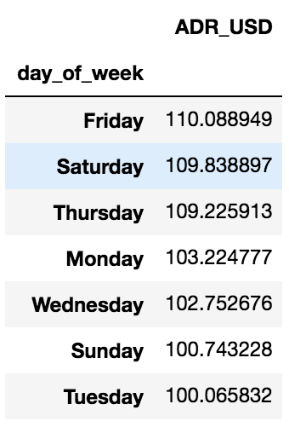
The average ADR is also higher in the weekends. (Fridays, Saturdays)
Notes:
From this table, it shows us the average ADR (Average Daily Rate) in different day of week in City A.
We can see that the highest average ADR belongs to Friday, and Saturday (having the rate $110, and $109.8 per night)
Compare to the lowest ADR in Tuesday (which is only $100 per night)
This tells us that not only, more records are booked for Fridays and Saturdays,
But also, the price per night is also higher for these two days.
Next Slide
(12:00)

Slide 21
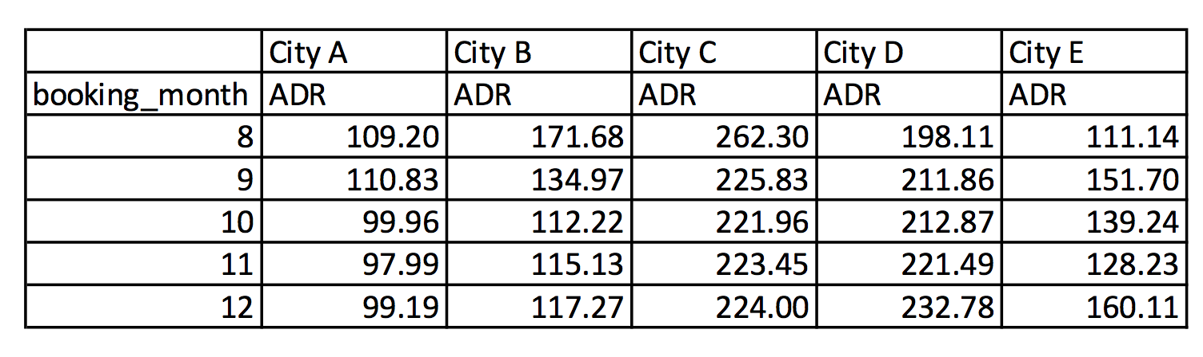
The average ADR reaches the highest in August and starts to decrease all the way to December.
(Except for City D, City E) City D is the opposite, and City E doesn’t have a clear pattern.
Notes:
The next finding is focusing on the price in the booking-month’s perspective.
The table shows us the average ADR in each booking-month for each city.
So for City A, B and C, we can see that the average ADR of each month is decreasing month-by-month.
However, City D is the opposite, it has an increasing average ADR,
and City E doesn’t have a clear pattern.
The reason might be something special about these two cities,
maybe something with the accommodation type structure, or maybe something about the city itself.
For example:
Let’s say City D is a City in Northern Europe. And they celebrates Christmas a lot.
So there are tons of festivals going on in December (Christmas holiday), and people visit City D to engage in the Christmas vibe.
Well, That will lead to an increase in price when the booking date approaches Christmas.
So that might be an explanation for this anomaly.
But of course, this is just an assumption, since we don’t have any information about these 5 cities.
For now, we can only say that in general:
The average ADR reaches the highest in August and starts to decrease all the way to December.
Next slide
(14:02)

Slide 22
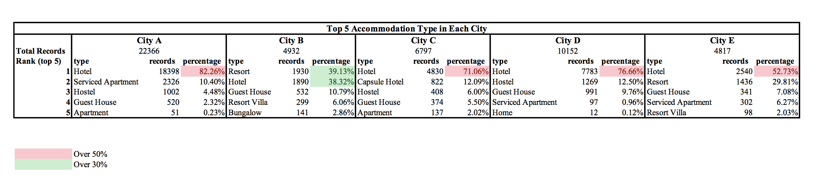
The structure of the accommodation type in each city is different.
For City A, C, D, E, most of the bookings were made for the “hotel” type. On the other hand, City B seems to be a Resort City.
Notes:
The next finding is focusing on the structure of the accommodation type in each city.
This table lists out the top 5 accommodation types that owns the most booking records.
So for City A, C, D and E, most of the bookings are for the “hotel” type.
We can see that the percentage of the bookings for the “hotel” type is more than 50% of the total bookings in these cities.
(The exact percentage is colored in red)
On the other hand, For City B, there is no accommodation type that represents more than half of its total bookings.
But, we can see that the two higher percentages belongs to the “Resort” type and the “Hotel” type. (which is colored green)
Having such a high percentage for “Resort” accommodation, it might indicate that City B is a “Resort City”, like Hawaii’s Honolulu.
That’s something we can indicate from analyzing the number of bookings in different accommodation type.
Next slide
(15:31)

Slide 23
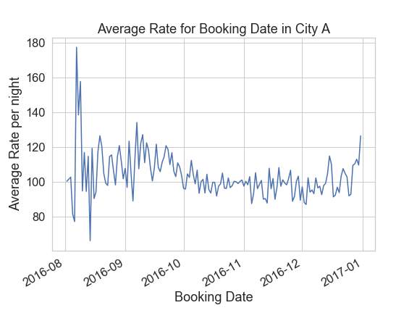
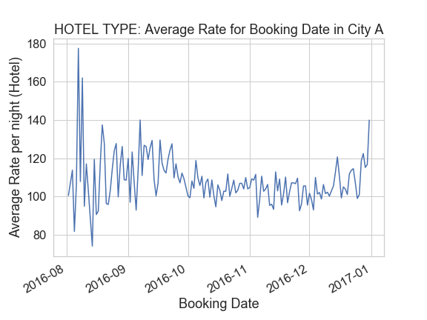
“Hotel type” is the biggest factor that contributes to the average ADR in the city as a whole.
Notes:
So now, Since we have an idea of the structure of accommodation types.
In the following two slides,
I focus on how the average ADR in the top accommodation type contributes to the city’s average ADR as a whole.
On this slide, the plot on the left is the distribution of average ADR over different booking dates for City A.
And the plot on the right is the ”hotel” type’s distribution of average ADR over different booking dates for City A.
We can see that these two plots look almost the same!
That indicates for City A,
the “Hotel type” is the biggest factor that contributes to the average ADR in the city as a whole.
Next slide

Slide 24
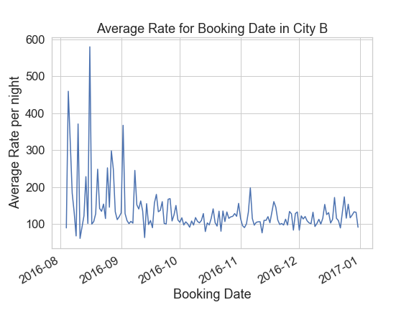
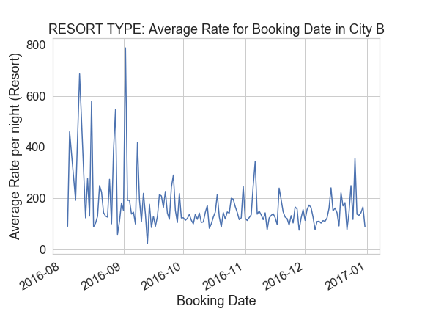
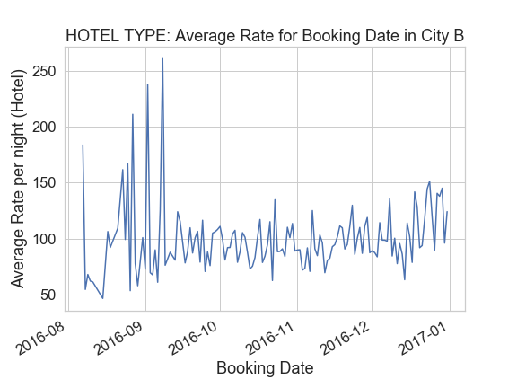
For city B, the “resort type” contributes more
Notes:
This slide is for City B
The plot on the left is the distribution of average ADR over different booking dates for City B.
And the plot in the middle is for the “Resort” type only.
And the plot on the right is for the “Hotel” type only.
Let’s take a look at the left portion for each three plots. Focusing on the higher peeks.
SO for booking dates in August, we can see that the high ADR is driven more by “Resort” type, not “Hotel” type.
Because the value for “Hotel” type around August, drops to $50 per night,
Whereas, the “Resort” type have similar patterns to the general one.
This once again, gives us evidence about our hypothesis that City B is a ”Resort City”
(17:40)

Slide 25
When the check-in dates are approaching the end of the year, people tend to book earlier.
Also, the average ADR increases as it moves toward the end of the year.
Notes:
So for the following slides, I’m taking the days that people book early into account in my analysis.
What I mean here, is the “day difference” in each pair of booking date, and check-in date.
Which means the days that people book ahead for a fixed check-in date.
For example: if the booking date is October 27th, and the check-in date is October 29th, then the day difference will be 2 days.
In other words, this customer booked two days ahead of the fixed check-in date.
So the finding of taking the “day difference” into account is that
When the check-in dates are approaching the end of the year, people tend to book earlier.
And the average ADR increases as it moves toward the end of the year.
Next slide

Slide 26
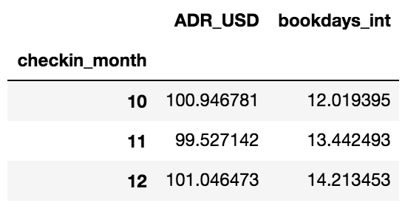
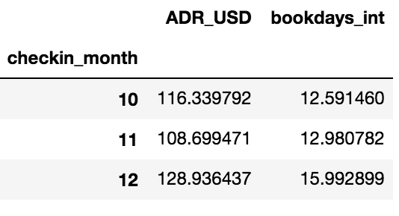
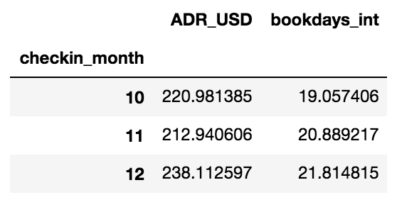
Average Days to book ahead and the average ADR in each check-in month in each city
Notes:
So the following are 5 tables, for the 5 cities
each representing the average ADR and the “day difference” in different check-in month.
Focusing on the ADR first, we can see that when the check-in date approaches the end of the year,
Which is December, it has the highest average ADR in all 5 Cities.
On the other hand, for the “day difference”, which is named as “bookdays_int” in the column.
We can see that the number of “day difference” increases.
So For City A, which is the First table on the left,
We can see that the average days that people book ahead is 12.01 days for a Check-in date in October,
And For November, the average is 13.44 days,
And For December, the number of days increases to 14.2 days.
For the other plots, it shows the same thing.
Next slide

Slide 27
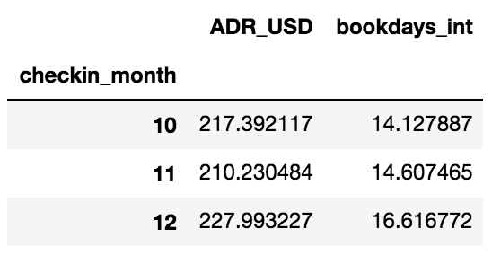
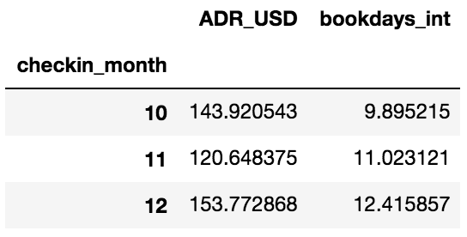
Notes:
These are The Tables for City D and City E
So we can see that
All 5 tables have this pattern of an increase in the average days to book ahead.
(20:50)

Slide 28
SEGMENTATION: "HOLIDAYS"
Important Holidays (in United States):
Veterans Day(Regional) 11/11/2016 Friday
Thanksgiving(National) 11/24/2016 Thursday
Black Friday 11/25/2016 Friday
Christmas Day(National) 12/26/2016 Mon
Notes:
Ok, Now,
let’s setup some fixed check-in dates so that we can do cross examination for the “day difference” with other factors.
So the fixed check-in dates that I chose, is the most important holidays based on the calendar of the United States.
We have
Veterans Day on November 11th,
Thanksgiving on November 24th,
Black Friday on November 25th,
And Christmas on December 26th

Slide 29
The 3 Main Long Weekends
Taking the idea of long weekend into account, it is reasonable to add in the weekends (Fri, Sat, Sun) that comes right before and right after the important holidays, the following will be the 11 main dates for "long weekend" (that might have a higher travel rate):
Notes:
So for these “Holiday” Check-in dates, we can take the idea of “long weekend” into account.
Since it is reasonable to add in the “weekends” that comes right before and right after the important holidays.
So that transforms the Holidays into the 3 Main Long weekends.
(22)

Slide 30
Veterans 11/11/2016 Fri 11/12/2016 Sat 11/13/2016 Sun
Thanksgiving + Black Friday 11/24/2016 Thu 11/25/2016 Fri 11/26/2016 Sat 11/27/2016 Sun
Christmas 12/23/2016 Fri 12/24/2016 Sat 12/25/2016 Sun 12/26/2016 Mon
Notes:
So for the Veteran’s ”Long Weekend” there are 3 days
And 4 days for the Thanksgiving’s “Long weekend”
And 4 days for Christmas’s “Long Weekend”

Slide 31
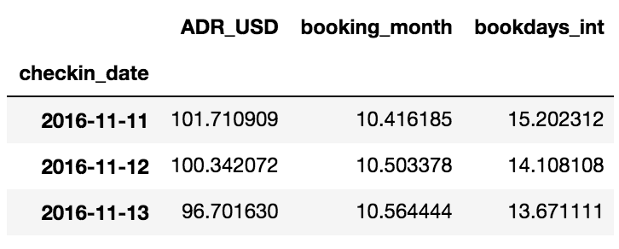
The average ADR, Book Ahead Days of Veterans Long Weekend
Notes:
So For “Veteran’s Long weekend”,
The average ADR for the 3 days are listed,
$101.71 for 11/11
$100.34 for 11/12
$96.70 for 11/13

Slide 32
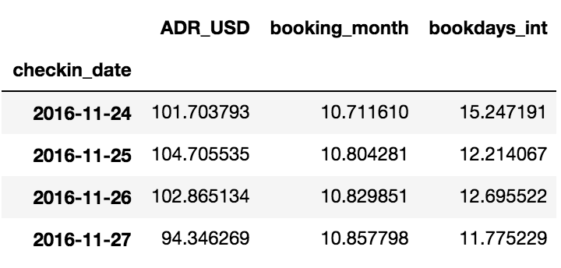
The average ADR, Book Ahead Days of Thanksgiving Long Weekend
Notes:
And For the “Thanksgiving Long weekend”,
The average ADR for the 4 days are listed,
$101.70 for 11/24
$104.70 for 11/25
$102.86 for 11/26
$94.34 for 11/27

Slide 33
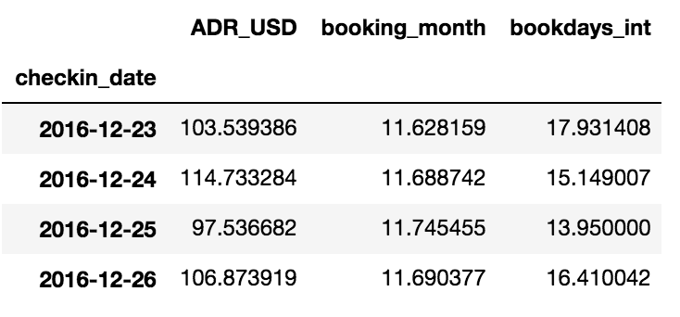
The average ADR, Book Ahead Days of Christmas Long Weekend
Notes:
And For the “Christmas Long weekend”,
The average ADR for the 4 days are listed,
$103.53 for 12/23
$114.73 for 12/24
$97.53 for 12/25
$106.87 for 12/26
(24:01)

Slide 34
The average ADR of 3 long weekend holidays
All seems to be around $100/night.
Veterans: $99.58
Thanksgiving: $100.91
Christmas: $105.67
Notes:
And for the overall average ADR in each long weekends
Veterans Long Weekend has an average of : $99.58
Thanksgiving Long Weekend has an average of : $100.91
Christmas Long Weekend has an average of : $105.67
Which all seems to be around $100 per night
Next slide

Slide 35
The average ADR for a random normal day
10/03/2016 is a normal day (Monday, not weekend, not holiday)
The average of ADR for this day is $93.23
We can see a big difference in the price for a holiday compare to a normal day
Notes:
And Compare that to the average ADR for a random normal day.
In this case I chose October, the 3rd
Which is just a normal day that’s not weekend and not holiday.
It turns out that the average ADR for this day is $93.23
So now,
We can see a big difference in the average ADR for a fixed check-in date that is a holiday and a normal day
(25:05)

Slide 36
Set up a fixed Check-date
Let's set up a FIXED check-in date, and take a look at the distribution of the days booking ahead and the average ADR.
Notes:
Now I randomly picked 1 day in each 3 Long Weekend Holidays
11/13 For Veteran’s Long Weekend
11/25 For Thanksgiving’s Long Weekend
12/25 For Christmas’s Long Weekend
And Let’s visualize the relationship of the average days that people ahead with the average ADR.

Slide 37
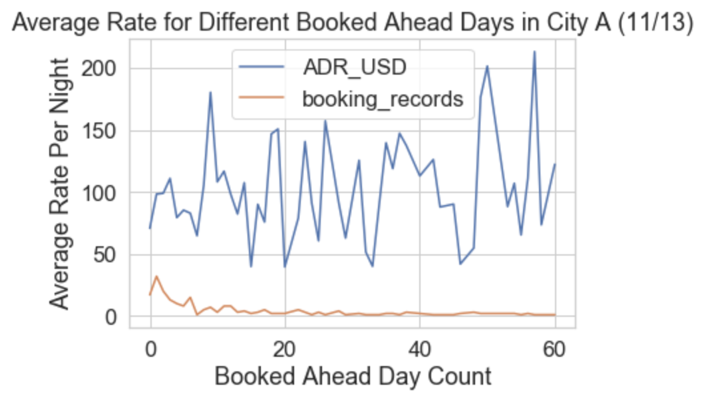
Fixed Check-in Date on holiday (11/13)
Notes:
We can see For the fixed Check-in date November 13th
The Average ADR is lower when the booking date approaches the Check-in Date,
which is when the “Booked Ahead Day Count”, the x-axis approaches to the left, reaching 0.
(It is colored as the blue line)
And on the other hand, the number of Booking increases when it’s closer to the Check-in Date (which is colored as the orange line)
Next Slide

Slide 38
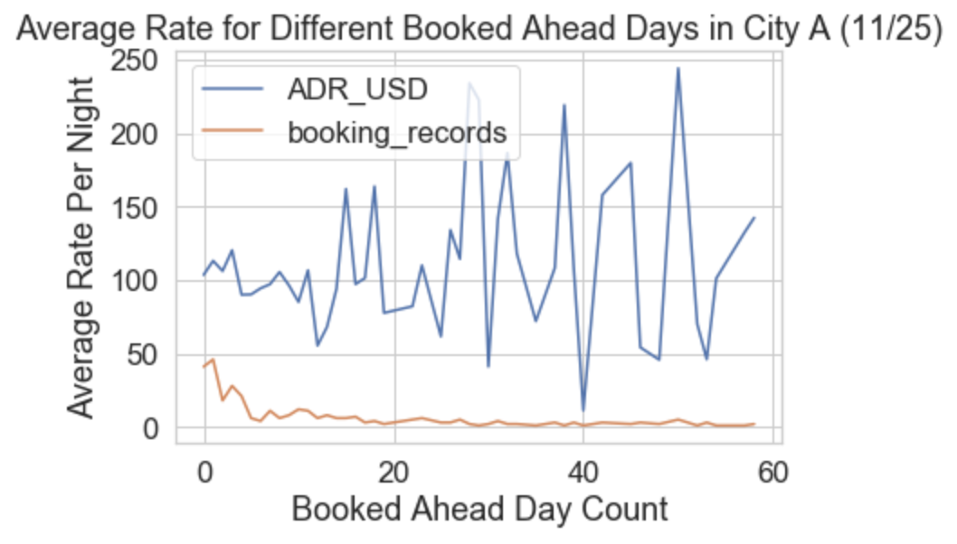
Fixed Check-in Date on holiday (11/25)
Notes:
And the same results can be concluded for the other two Fixed Check-in Dates
November 25th, and December 25th,
Which is shown in the next slide.

Slide 39
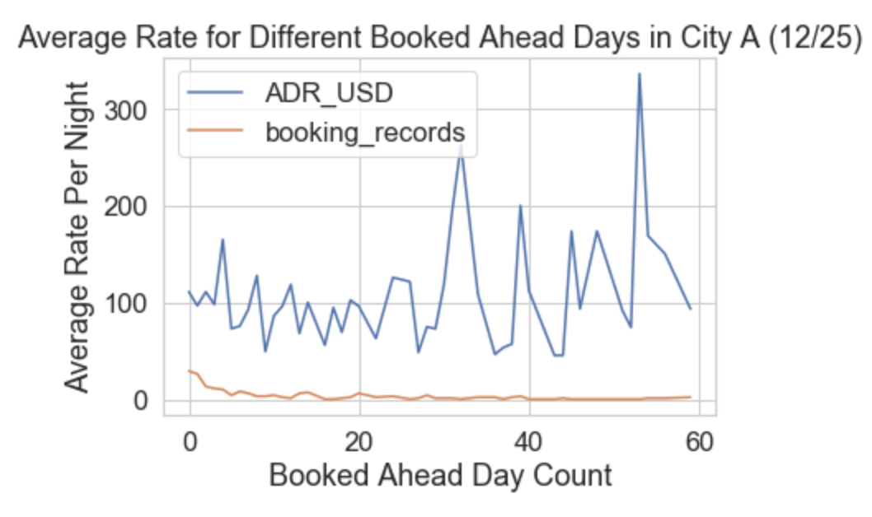
Fixed Check-in Date on holiday (12/25)
Notes:
So this is all of my Key Findings when I’m exploring the data,
And that brings up the conclusion in the next slide.
(26:40)

Slide 40
Conclusion
The distribution of the number of records over different booking date has the same pattern in all 5 cities.
The number of booking increases very fast around the end of September.
Most of the bookings were made in October, November and December.
The check-in records oscillate by the cycle of a week.
More check-in records in the weekends.
The average ADR is higher in the weekends. (Fridays, Saturdays)
The average ADR is higher on holidays.
Notes:
So the conclusion here, is a recall of all the important findings in the previous slides.
(27:30)

Slide 41
In general, the average ADR reaches the highest in August and starts to decrease all the way to December.
When the check-in dates are approaching the end of the year, people tend to book earlier. (Holiday Seasons)
The average ADR increases as the check-in date moves toward the end of the year. (Holiday Seasons)
Notes:
next slide
(28:03)

Slide 42
Recommendation (what time to implement)
Start implementing urgency messages around the end of September or the beginning of October.
When user search for check-in dates that are weekends (Fridays, Saturdays), implement the urgency messages, and provide discounts to increase the chance of booking.
Notes:
So the following two slides will be the recommendation that I would like to give to the product owner
So about “WHEN” to implement the urgency messages:
The First Recommendation is:
Start implementing them around the end of September or the beginning of October.
Because that is when the number of bookings started to increase very fast.
The Second Recommendation is:
Implement them when the user search for check-in dates that are weekends.
Because we already know from our findings that more bookings are made for Fridays and Saturdays.
On the other hand, The average ADR is also higher on these days,
and therefore, we can also provide some discounts to increase the chance of booking
(29)

Slide 43
Recommendation (Urgency Messages)
Implement urgency messages at the search results page, feature page and booking form.
Add numbers to the urgency messages because people are more sensitive to numbers.
“11 people are considering this hotel right now!”
“Someone booked 46 minutes ago!”
“Our last 3 rooms!”
Add ratings to the urgency messages.
“Good ratings 8.5! Book fast!”
“Great choice of property with average review score of 9.2!”
Notes:
And about “WHERE” to implement the Urgency Messages,
I would recommend to implement them on the search results page, the feature page, and the booking form page.
Also For the Urgency Message “itself”
I recommend adding some numbers and ratings to the messages,
because people are more sensitive when they see numbers.
For example,
“11 people are considering this hotel right now!”
“Someone booked 46 minutes ago!”
“Our last 3 rooms!”
“Good ratings 8.5! Book fast!”
“Great choice of property with average review score of 9.2!”
So these are the Recommendations that I would give.
Next Slide,

Slide 44
Missing Factors that might influence the analysis
Missing the customer review column.
If this factor is provided, we can perform cross examination on the relationship between booking numbers and the ratings in order to implement promotion strategies accordingly.
Missing the total number of room available column.
If this factor is provided, we could know the occupancy rate per night. If the occupancy rate is not as expected, more marketing promotion can be implemented.
Notes:
So During my Exploration, I noticed two missing factors that might influence the analysis.
The first one is the missing of the customer review column,
If this factor is provided, we can perform cross examination on the relationship between the booking numbers and the ratings
And we can implement promotion strategies accordingly. And increase the number of bookings
The second one is the missing of the available room column
If this factor is provided, we could know the occupancy per night.
And If the occupancy rate is higher than expected, more promotions and urgency messages can be implemented.
So this is ALL For My Analysis, and Thank you all for listening
(30:20)

